Slide 1

Implementing optimized form of support vector machine
African Institute for Mathematical Sciences (AIMS)
The African Master’s of Machine Intelligence (AMMI)
SUBJECT:
Members
Angela Musangi Munyao
Fibi Annan Metiki
Gilda Rech Bansimba
Mouhamadou Bamba DIOP

Slide 2

Plan
THEORETICAL CONCEPT
IMPLEMENTATION
PREPROCESSING
WORDS REPRESENTATION
RESULTS

Slide 3

THEORETICAL CONCEPT

Slide 4
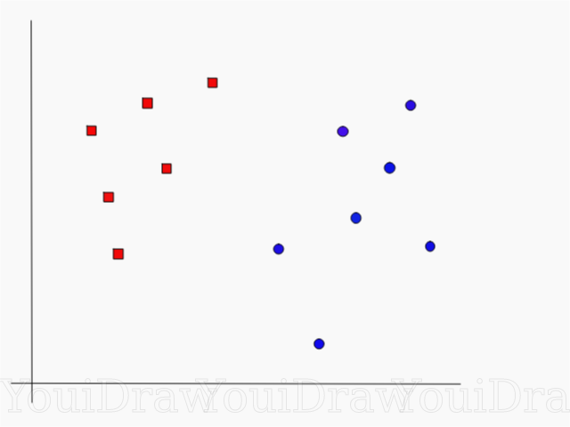
Support Vector Machine
SVM is a supervised machine learning algorithm that is usually used for both classification and regression problems. SVM maps training examples to points in space so as to maximize the width of the gap between the two categories. New examples are then mapped into that same space and predicted to belong to a category based on which side of the gap they fall.

Slide 5
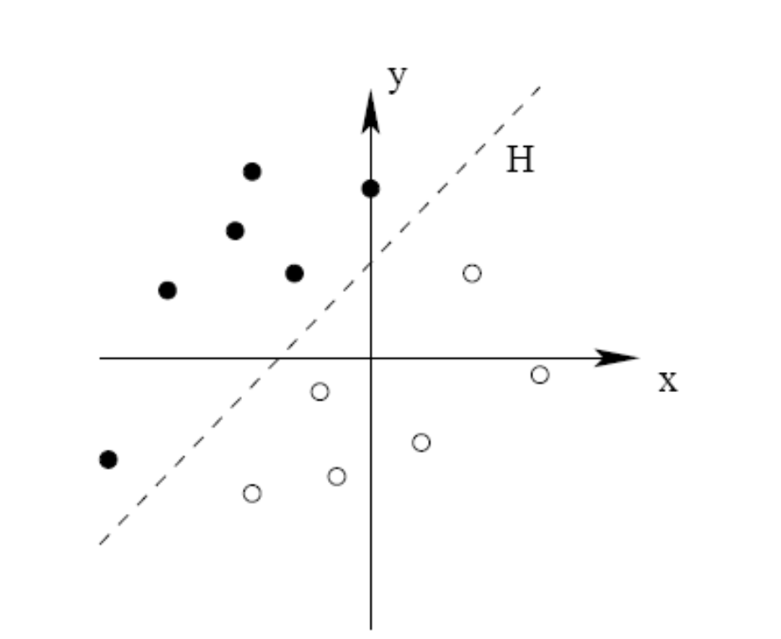
Linearly Separable Case
We assume that X = R^{d} and note ⟨·, ·⟩ the usual scalar product. The data (x1, y1), . . . (xn, yn) are said to be linearly separable if there exists (w,b) ∈ R^{d} × R such that for all i:
- Yi = 1 if ⟨w,xi⟩ + b > 0
Yi = -1 if ⟨w,xi⟩ + b < 0

Slide 6
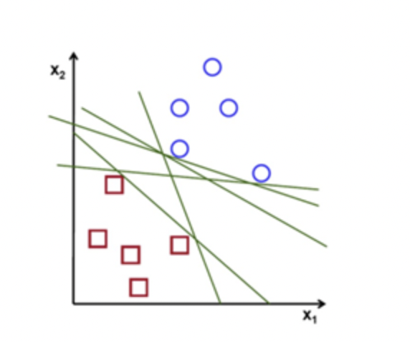
Separate the Data
It consists of finding the optimal line that allows a new point to be classified intelligently. It is based on the idea of the maximum margin, we take the two points of the two classes, closest to each other, then we draw a line equidistant between these two points, and this line is the decision frontier.

Slide 7
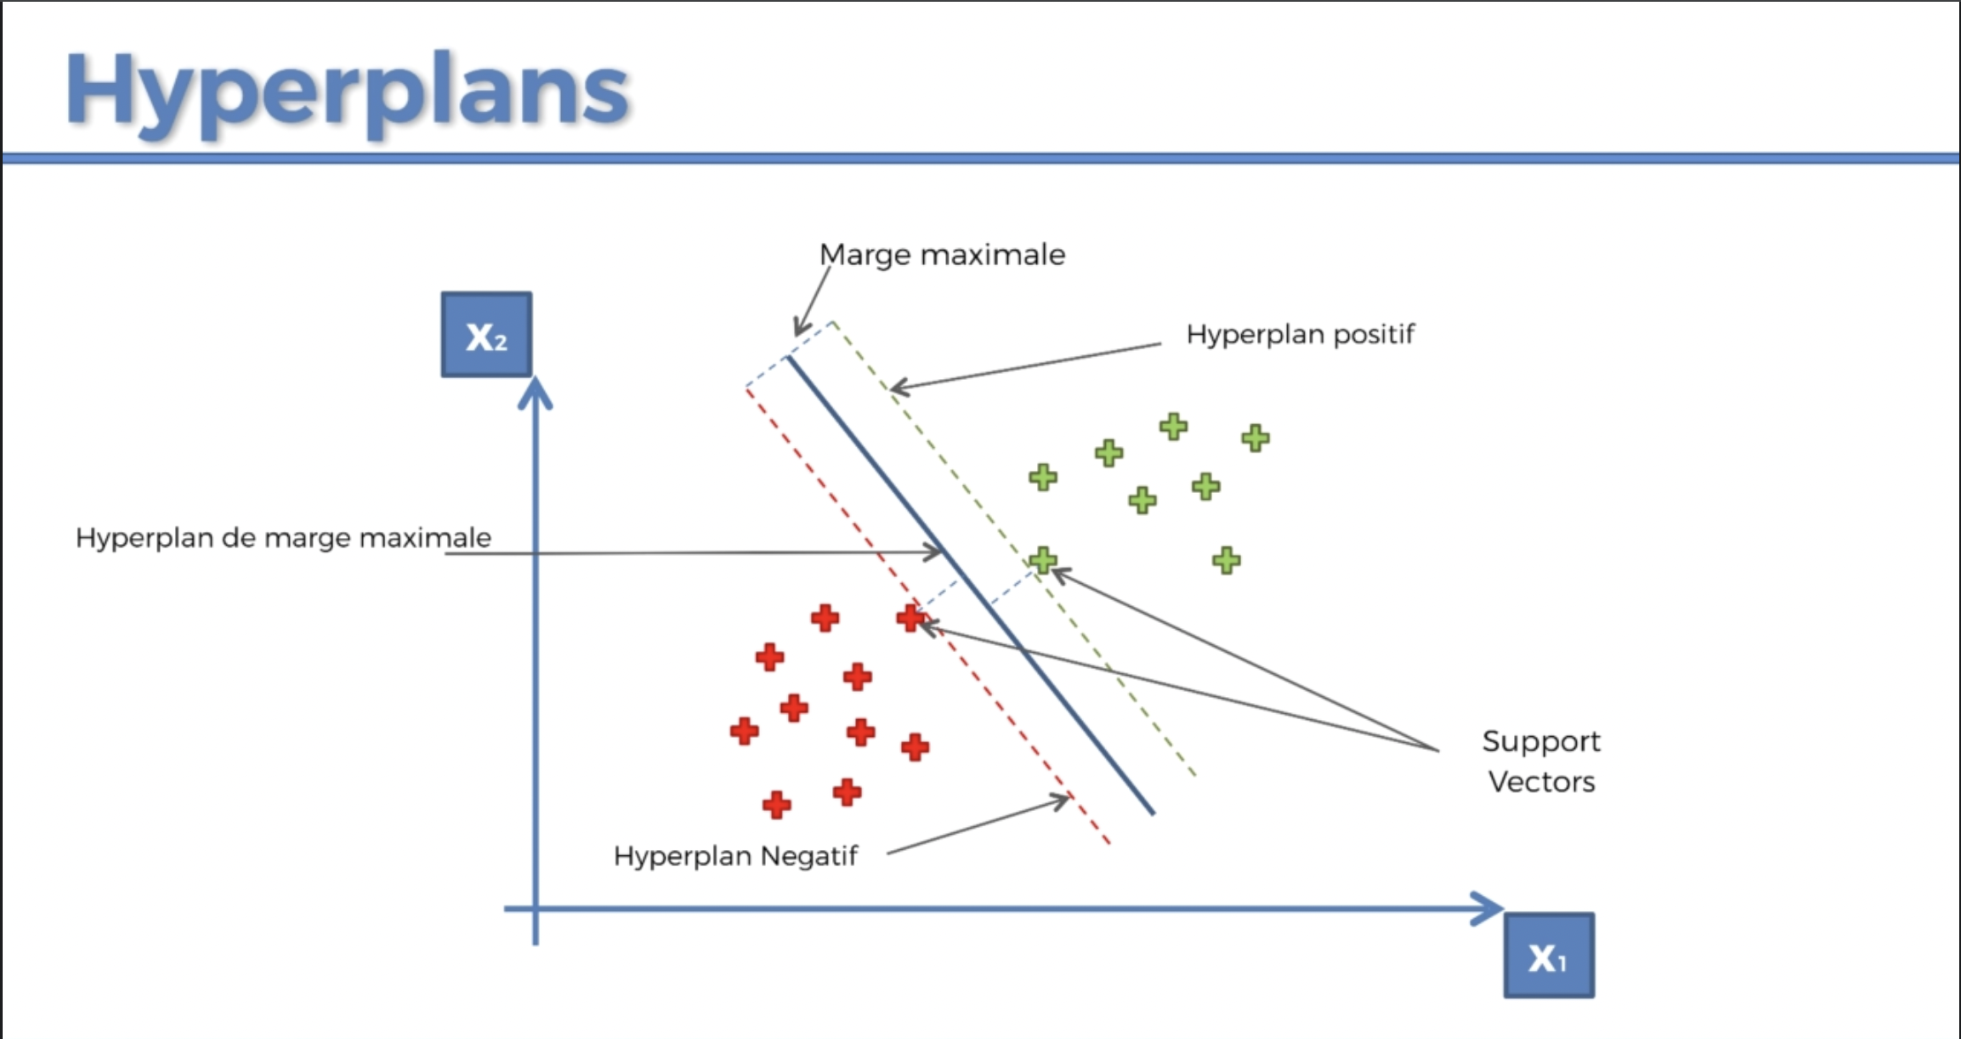
Optimal Line
This boundary has been chosen so that these two distances between the two red and green points are maximum in relation to the line. So the distance between these two red and green points and the line is maximum

Slide 8
Vectors instead of points
Because when we talk about a vector in a two-dimensional plane, it can be a vector separating two points in the plane, or it can be points, in which case the vector is the one from the origin to the points.

Slide 9
Why it is called support vector
Because these two points all support the model on their own, the other points do not play a role in the model. The hyperplane is the boundary of the prediction itself. The dimension of a hyperplane in N dimension is N-1.

Slide 10
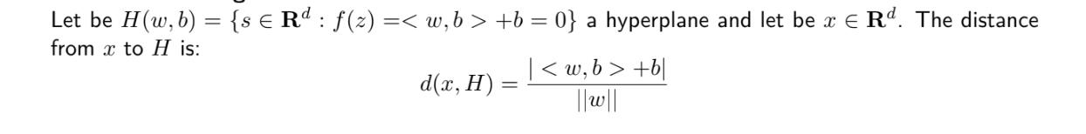
Distance of a point from the boundary of decision

Slide 11
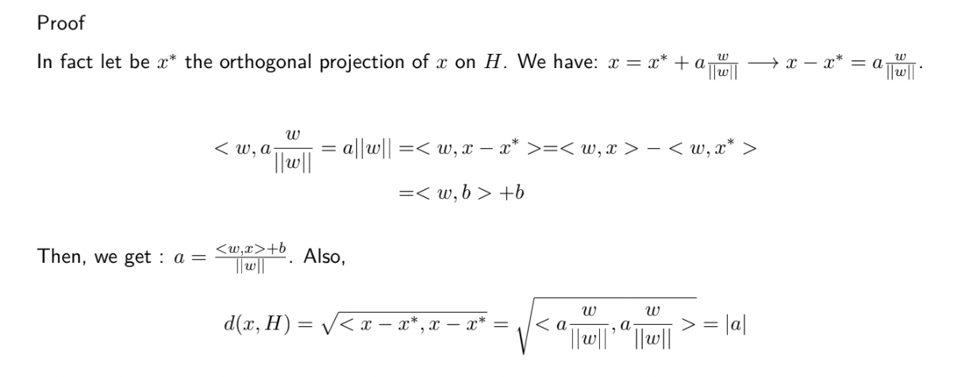
Proof

Slide 12
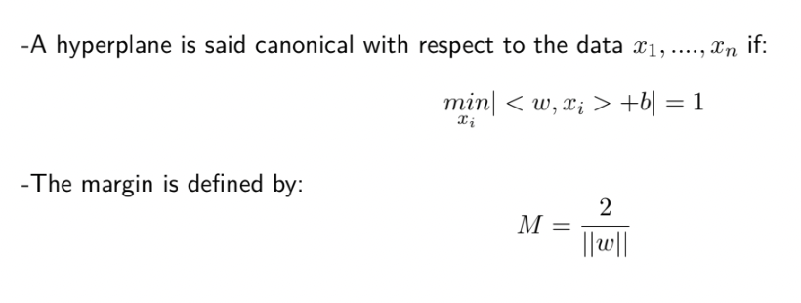

Slide 13
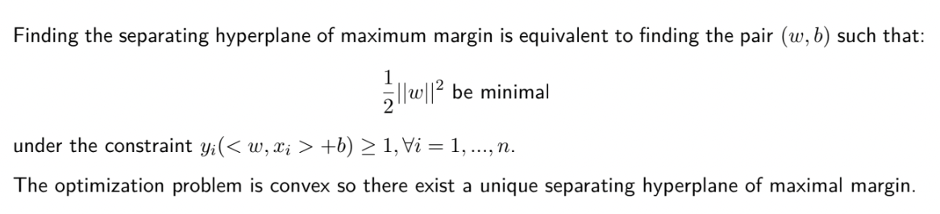
Primal expression of the SVM problem

Slide 14
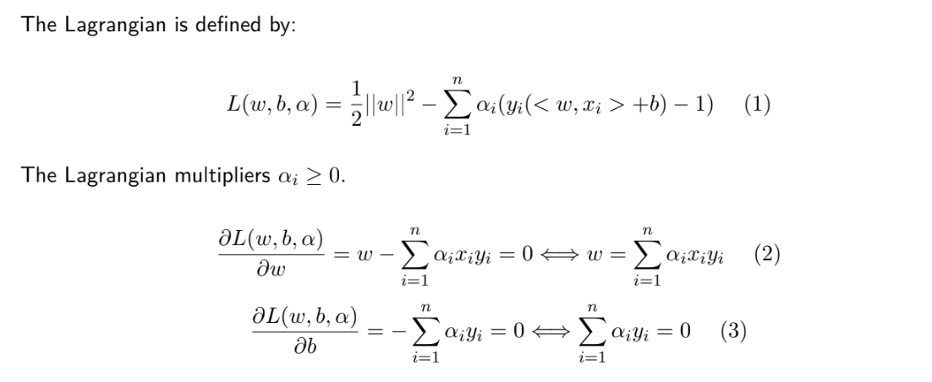
Lagrange multipliers

Slide 15
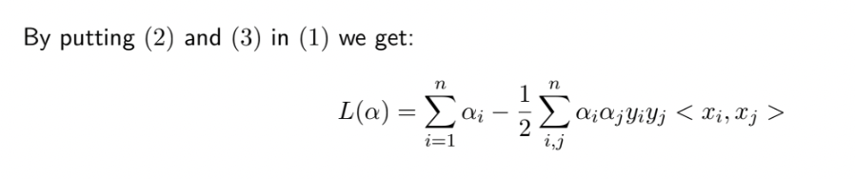

Slide 16
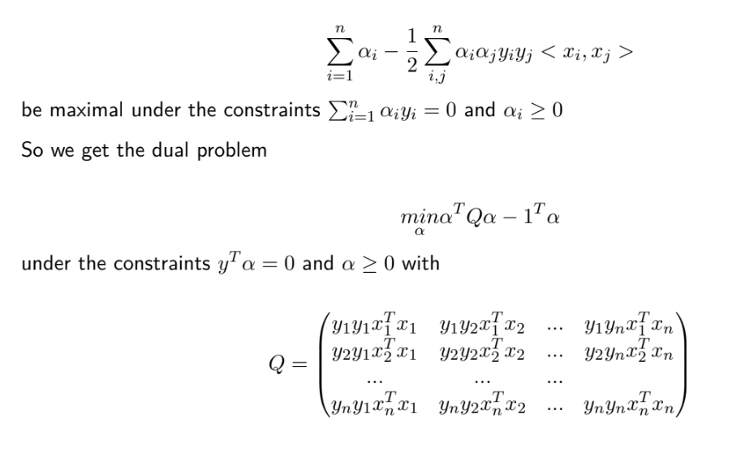
Dual expression of the SVM problem
Solving the dual problem amounts to finding α = (α1, ....., αn) such that:

Slide 17
IMPLEMENTATION

Slide 18
PREPROCESSING THE DATASET

Slide 19
WORDS REPRESENTATIONS

Slide 20
SVM Module Trained with SGD

Slide 21
Results

Slide 22
CONCLUSION

Slide 23
THANK YOU FOR YOUR KIND ATTENTION

